Slide 1
Evidence Search Techniques
Find command
Notes:
https://www.youtube.com/watch?v=6G3qm60dfA8&ab_channel=PrashantThombre

Slide 2
Objectives
Understand the goal of search
Search for files/directories base on names
Search for files/directories base on their metadata
Understand various timestamps
Why don’t trust search results

Slide 3
Goal of search
Retrieve all evidence that is related to crime activities
evidence are saved in file systems
Answer questions
who
when
what
how
Many search commands in Linux
ls, find, grep, locate, which

Slide 4
find command
Search files by
permissions,
users, groups,
file types, date, size, and
other possible criteria
find vs grep
both return file names
based on file metadata vs. file content
One of the most important commands
in computer forensics

Slide 5
Basic find command usages
name

Slide 6
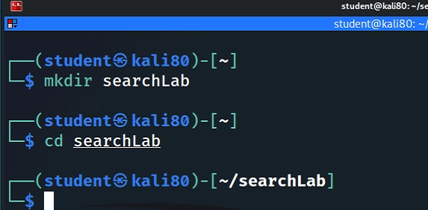
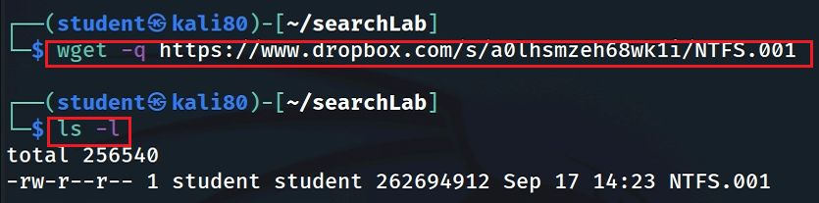
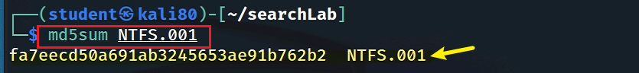
The lab uses a USB image
Create a working folder
Download a USB image

Slide 7
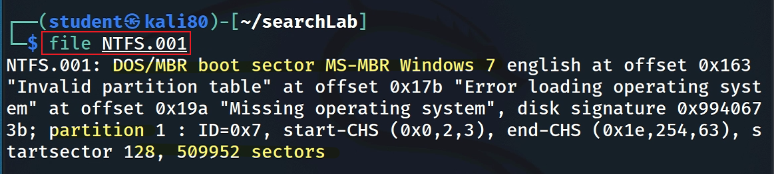
Show image information

Slide 8
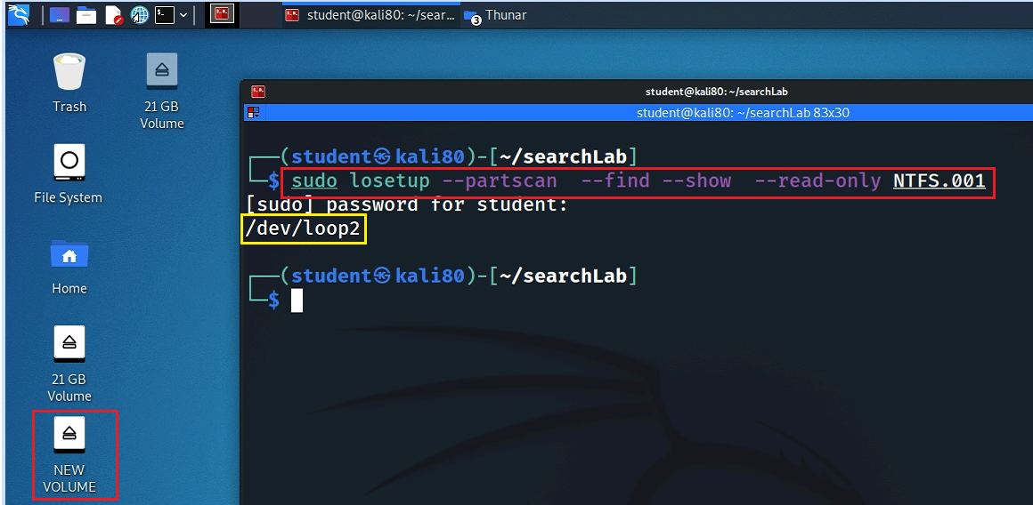
Mount the USB to Linux as a read-only loop device
Notes:
sudo losetup --partscan --find --show --read-only NTFS.001

Slide 9
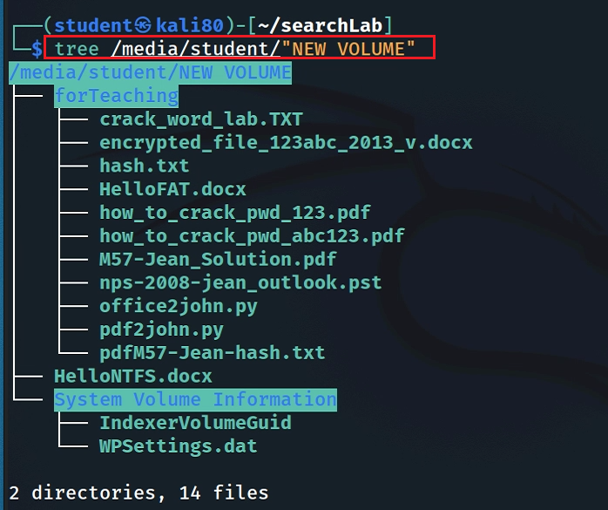
View file structure

Slide 10
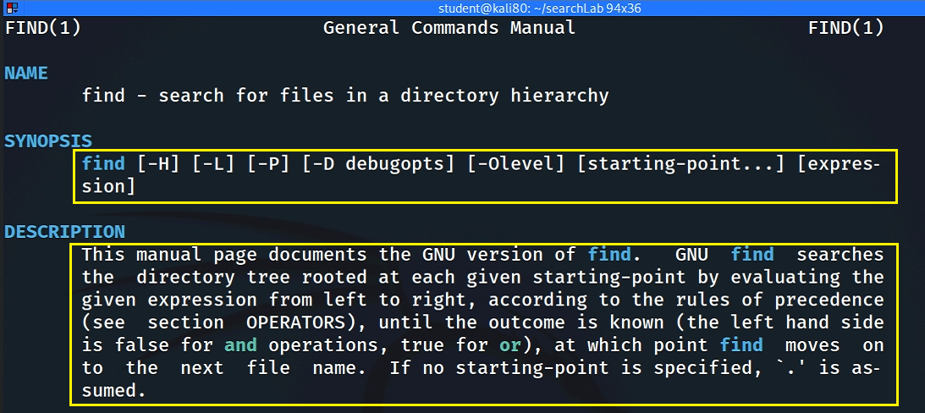
Syntax
$ find [where to start searching from] [expression determines what to find]

Slide 11
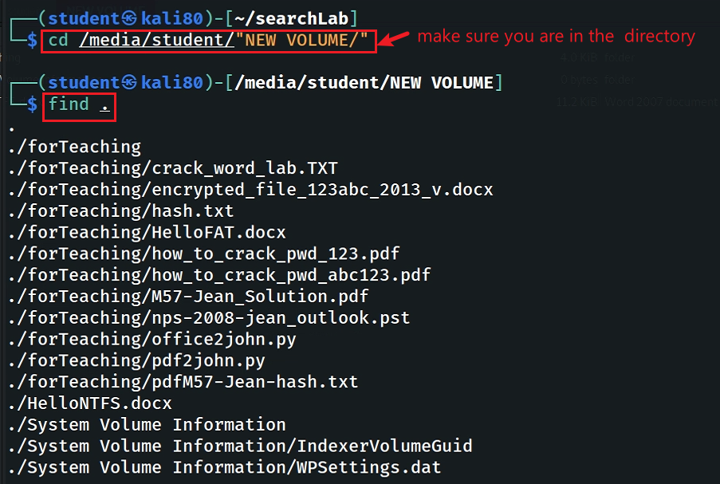
Find Files/directories starts from Current Directory (recursively)
include all subfolders, recursively

Slide 12
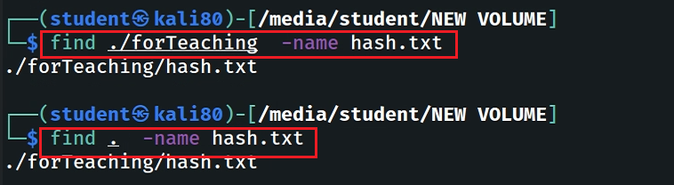
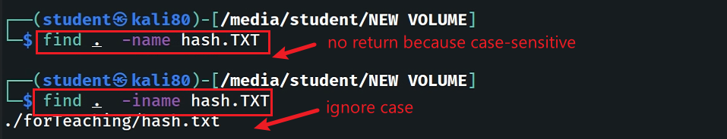
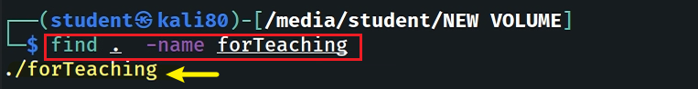
-name and -iname: find file/directory names
find a file
find a file and ignore case
find a directory

Slide 13
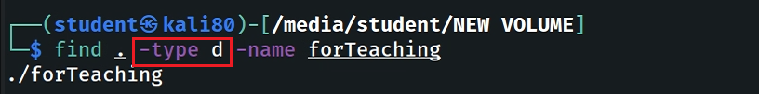
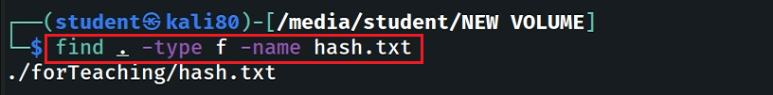
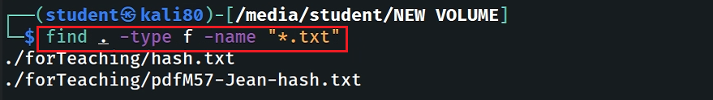
-type: specify string types
Specify the search type d: directory
Specify the search type f: file
Search all files with extension .txt

Slide 14
metadata and find usage
timestamps/permissions/users

Slide 15
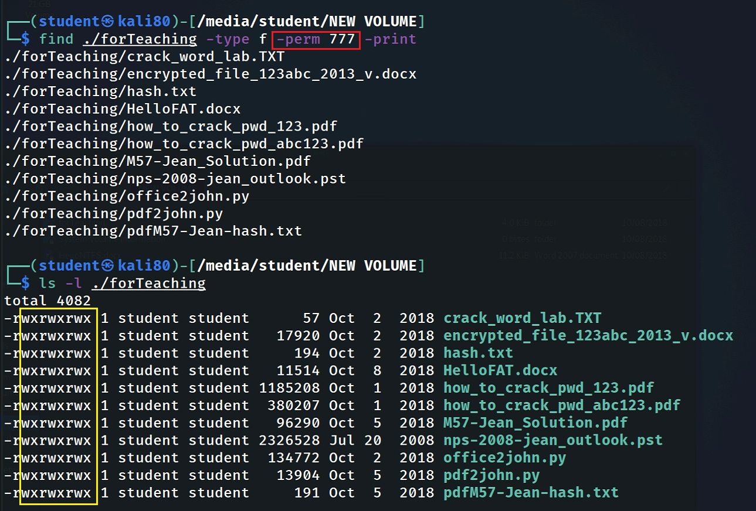
Find Files With 777 Permissions

Slide 16
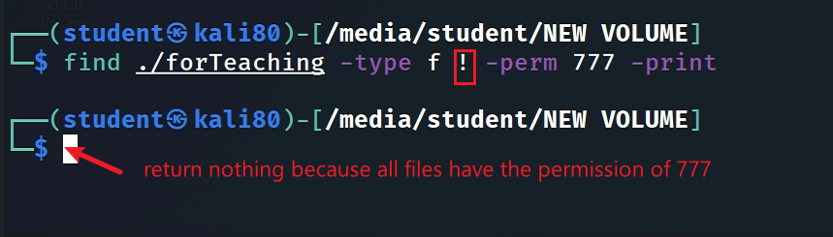
Find Files Without 777 Permissions
Note: we can’t change the permission of files here because we mounted the image as read only

Slide 17
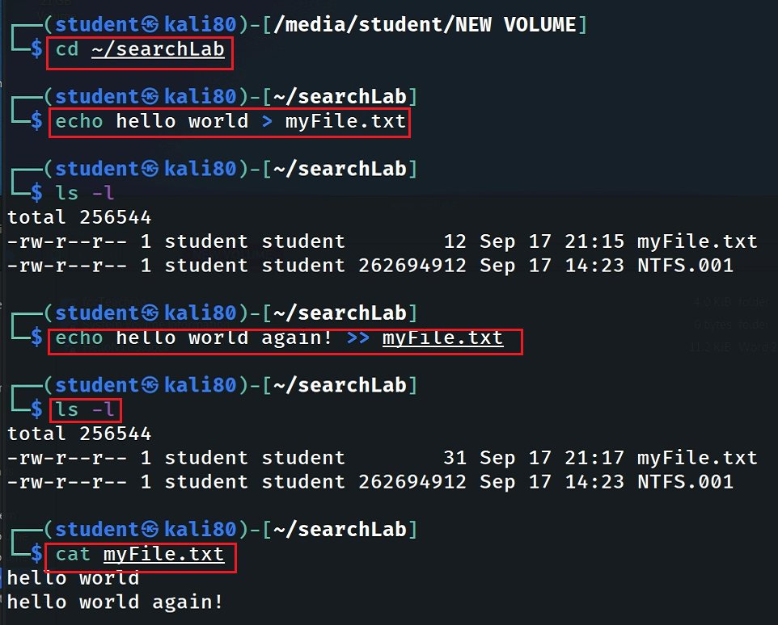
“atime”, “mtime” and “ctime”
Change working directory
Create a new file
Review the permission and timestamps
Modified a line
Review the permission and timestamps
Access the file content

Slide 18
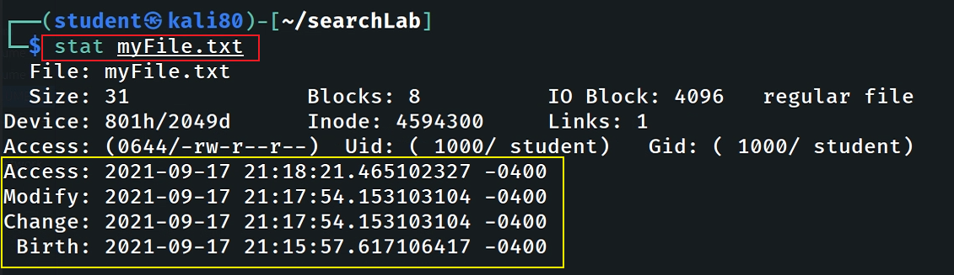
Difference Between “atime”, “mtime” and “ctime”
Timestamp | When it gets updated?
atime | Access time gets updated when you open a file or when a file is used for other operations like grep, cat, head and so on (not for stat command!).
mtime | Modify time gets updated when you whenever update content of a file or save a file.
ctime | Change time gets updated when the file attributes are changed, like changing the owner, changing the permission or moving it to another filesystem, but will also be updated when you modify a file.

Slide 19
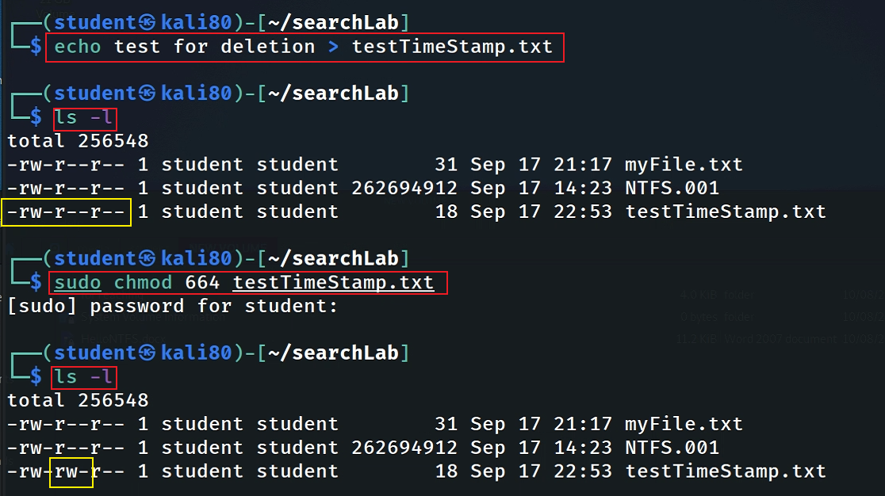
Timestamp changes when changing permission
Create a new file
Change permission
Change permission doesn’t change the timestamp (content)

Slide 20
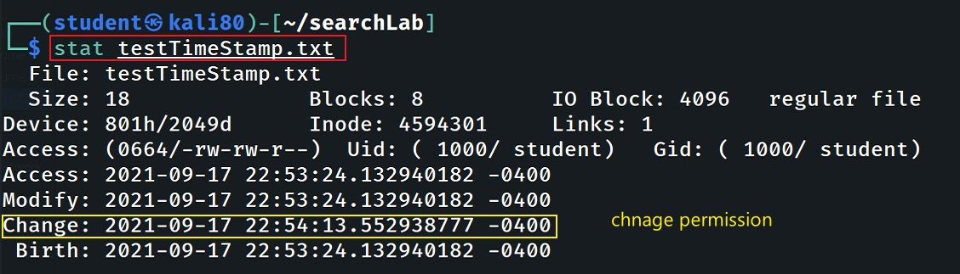
note: we did not modify the content of the file, so birth time=Modify time

Slide 21
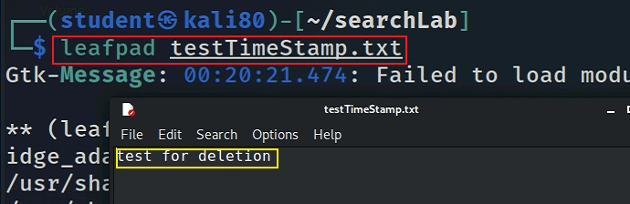
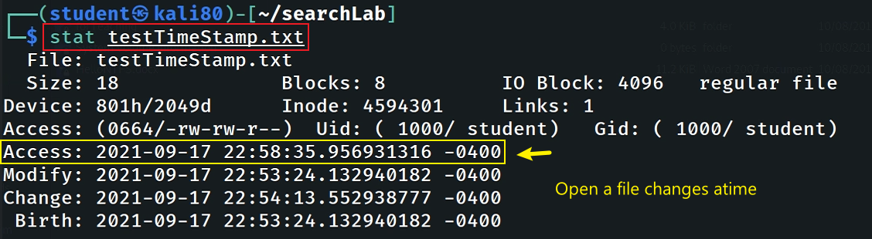
View (Access) the file with leafpad
Note: we did not change the content
Check timestamps
Note: mtime doesn’t change, but atime changed

Slide 22
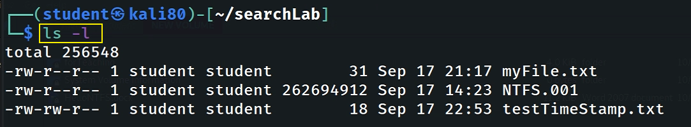
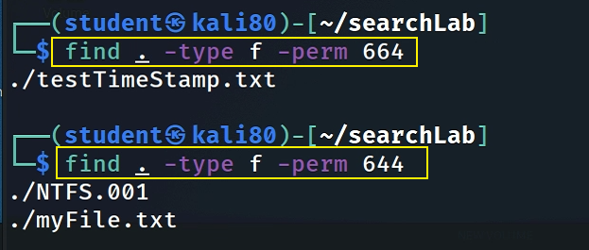
Find Files With –perm=xxx Permissions

Slide 23
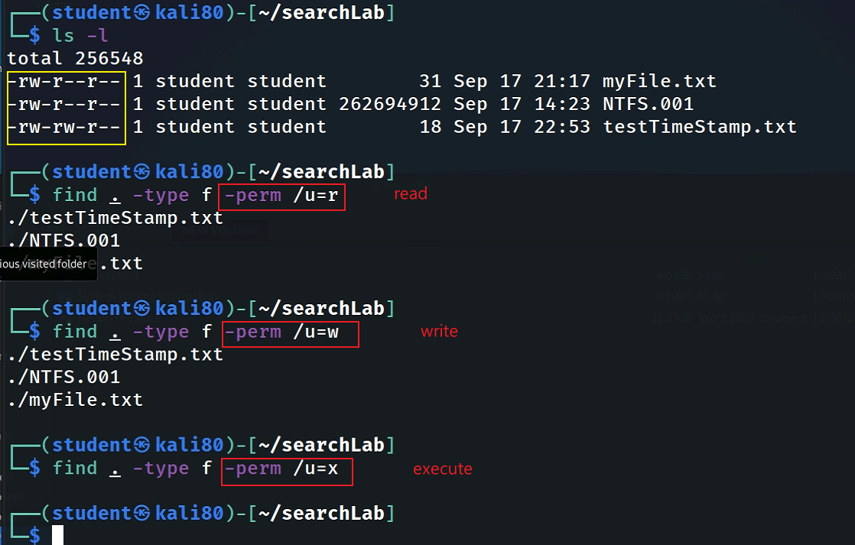
Find Files With /u=r /u=w /u=x Permissions

Slide 24
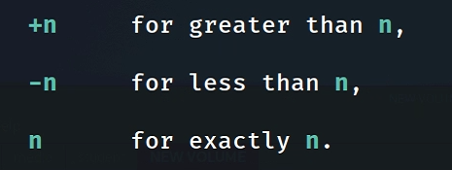
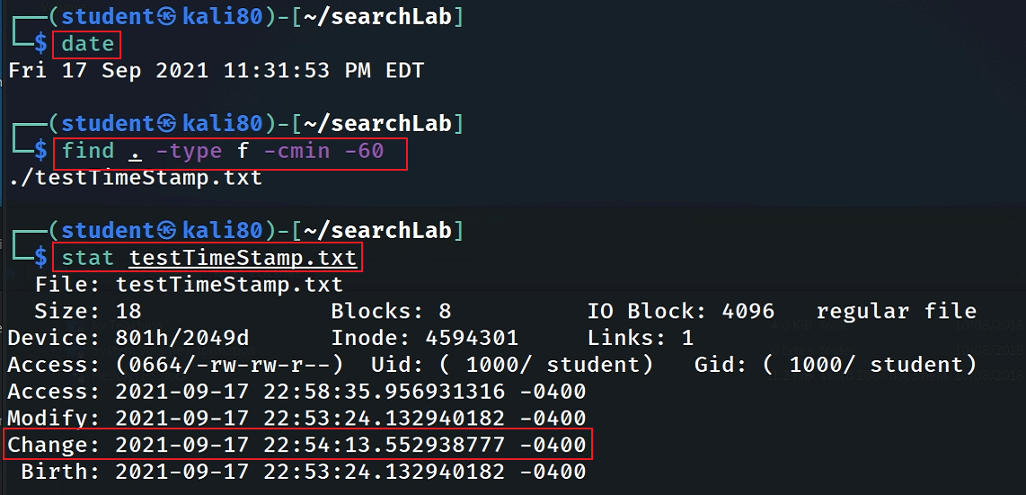
Find Changed Files in Last 1 Hour

Slide 25
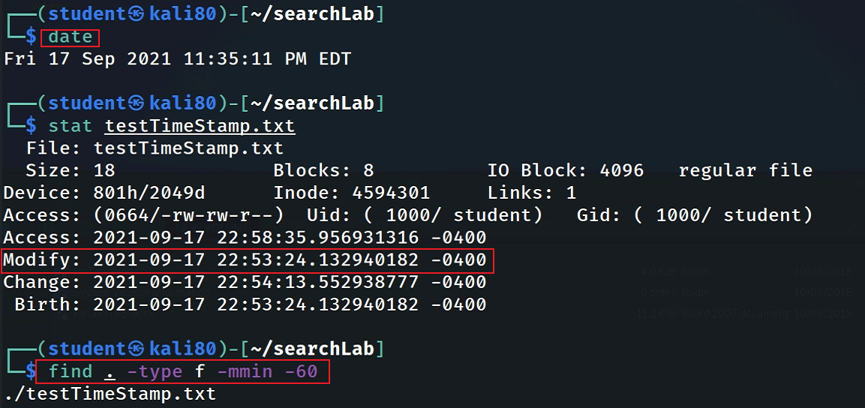
Find Modified Files in Last 1 Hour

Slide 26
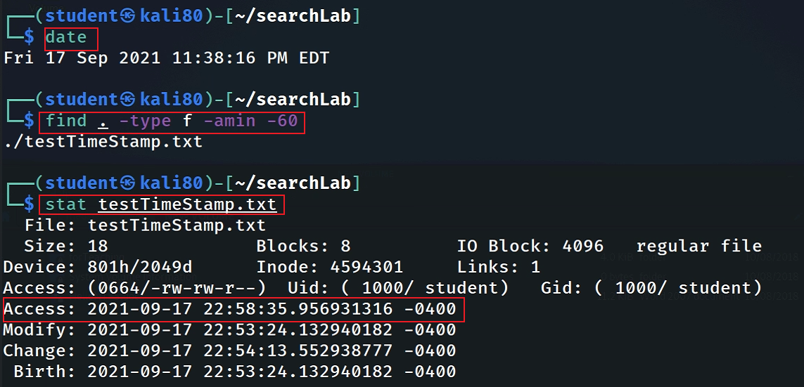
Find Accessed Files in Last 1 Hour

Slide 27
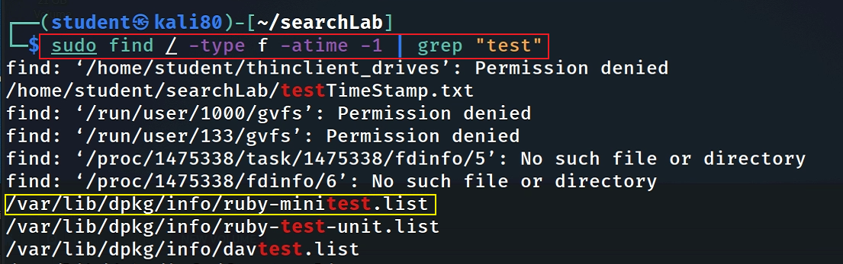
File was last accessed less than n*24 hours ago

Slide 28
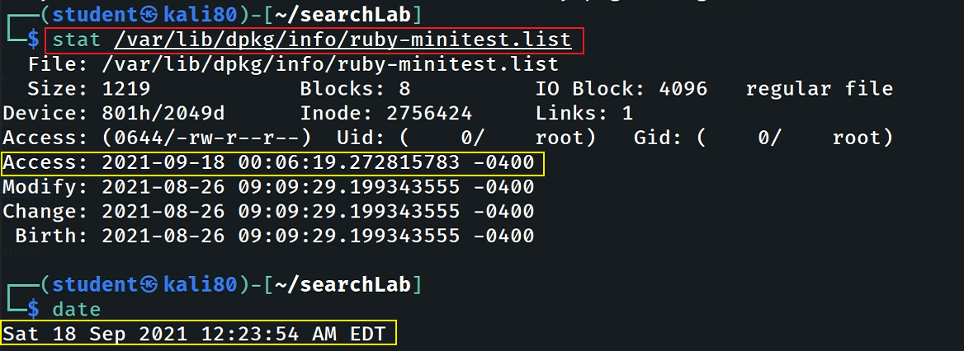
Verify file was last accessed less than n*24 hours ago

Slide 29
File was last modified/changed less than n*24 hours ago
try by yourself and verify your command!

Slide 30
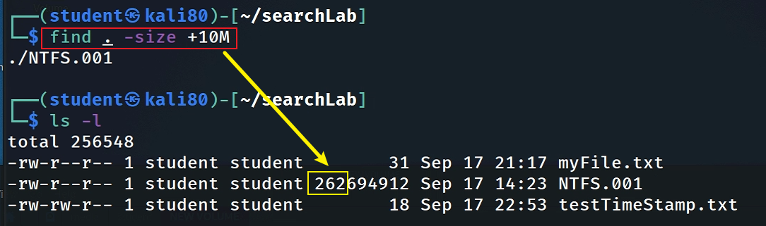
Find Size great than 10MB

Slide 31
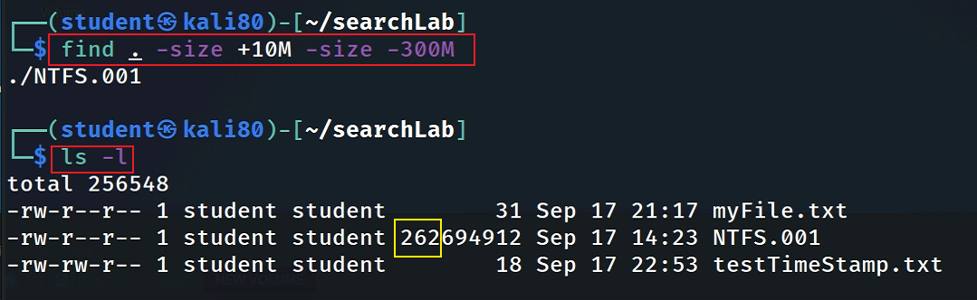
Find Size between 10MB and 300MB

Slide 32
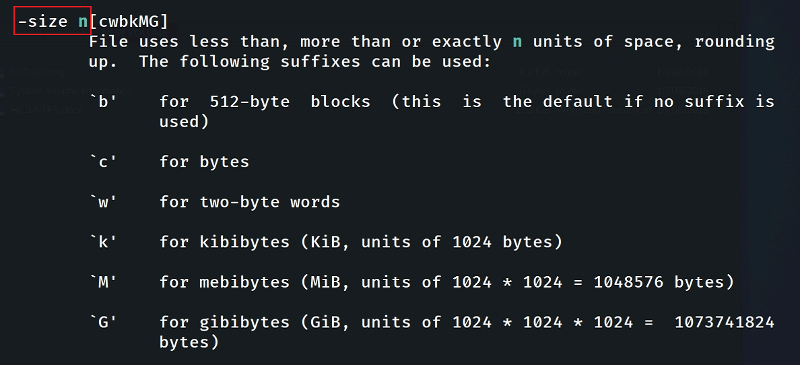

Slide 33
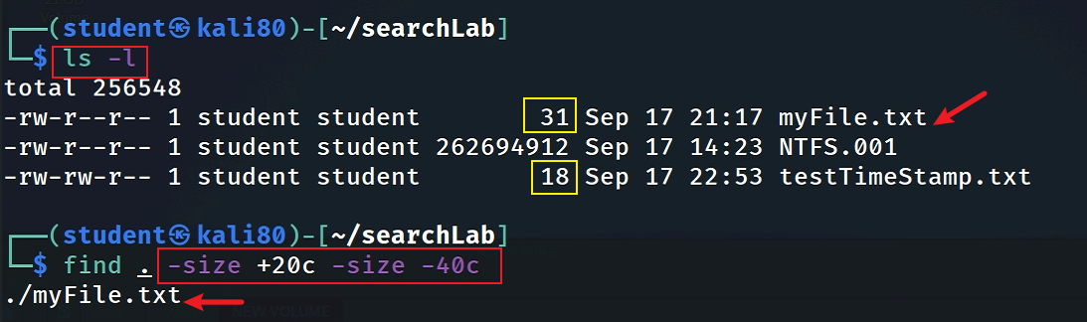
Find Size between 20 – 40 bytes

Slide 34
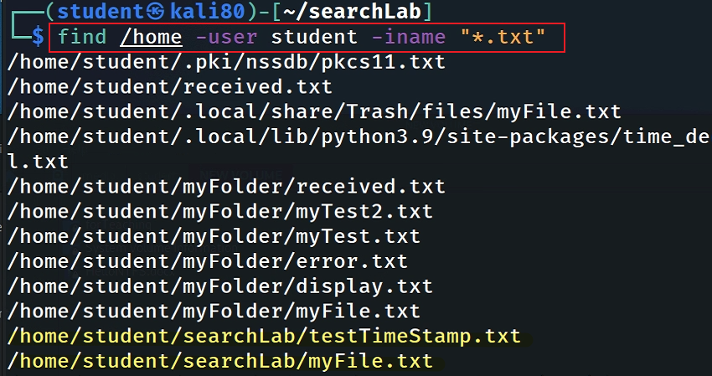
Find Particular Files of User
To find all .txt files of user student under /home directory.

Slide 35
Why don’t trust search results
anti-forensic
Notes:
https://www.shellhacks.com/fake-file-access-modify-change-timestamps-linux/

Slide 36
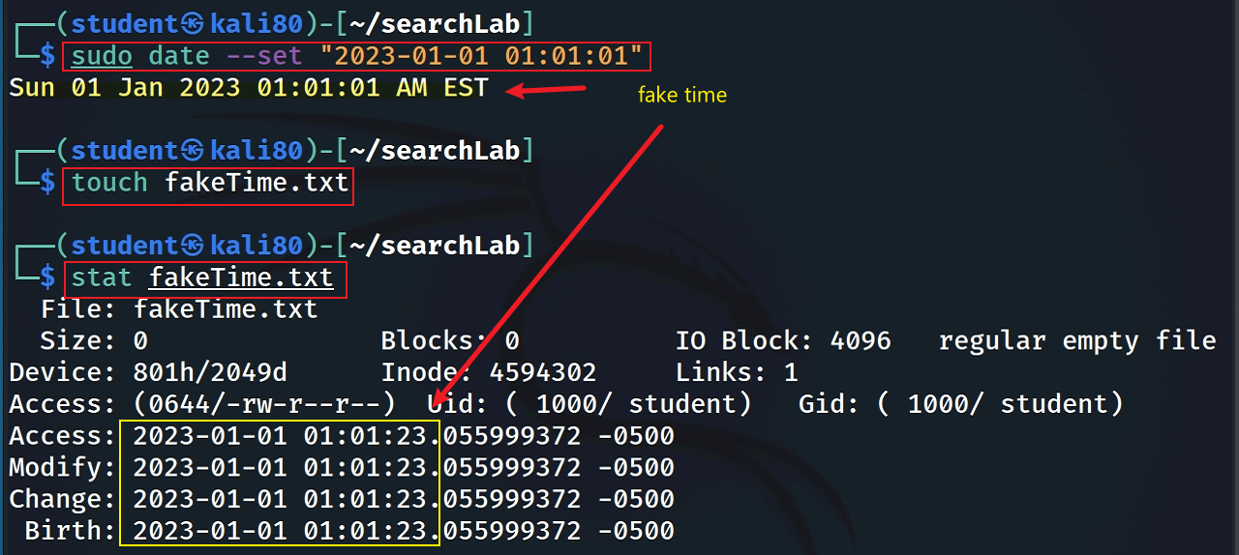
Set fake [amc]time by changing system time
Notes:
sudo date --set “2023-01-01 01:01:01”

Slide 37
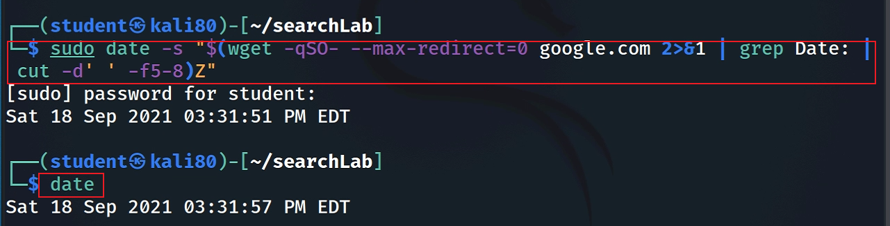
Reset time back to correct time
sudo date -s "$(wget -qSO- --max-redirect=0 google.com 2>&1 | grep Date: | cut -d' ' -f5-8)Z"
Notes:
sudo date -s "$(wget -qSO- --max-redirect=0 google.com 2>&1 | grep Date: | cut -d' ' -f5-8)Z“
https://askubuntu.com/questions/81293/what-is-the-command-to-update-time-and-date-from-internet

Slide 38
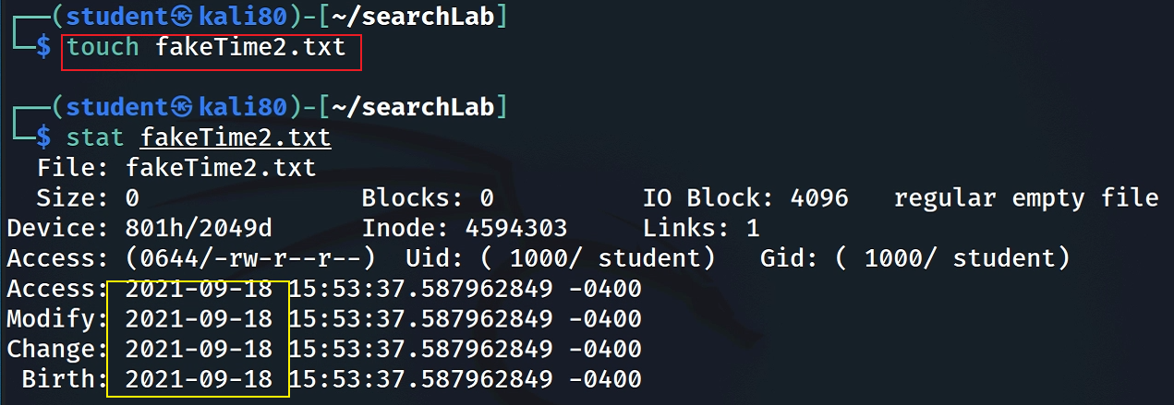
Set fake time using touch -t
Create a normal file

Slide 39
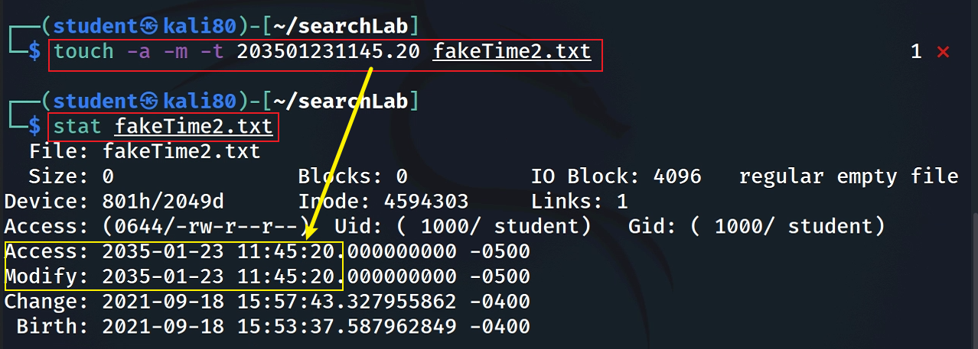
Create a normal file
touch -t [[CC]YY]MMDDhhmm[.SS]
touch -a -m -t 203501231145.20 fakeTime2.txt

Slide 40
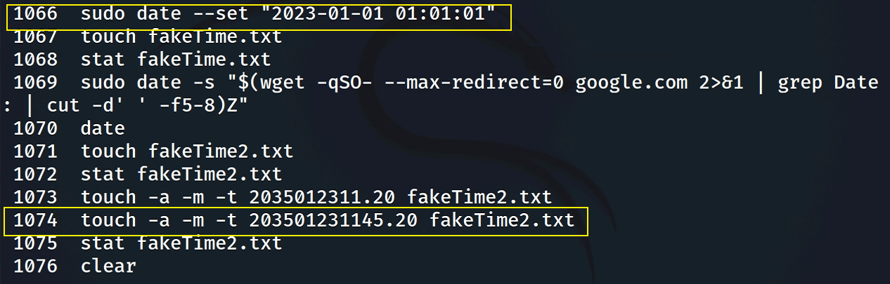
Anti-anti-forensics

